Slide 1
Café 21CS Cashiering System
A presentation by:
Adeel Shah: 21CS041 Muhammad Sameer: 21CS077 Mashaal Zulfikar: 21CS105

Slide 2
Introduction
Overview
Cafe 21CS Cashiering System
a web-based application.
Purpose
Streamlines daily sales transactions and enhances operational efficiency.
Technology
PHP (backend), MySQL (database), HTML, CSS, JS, Bootstrap (frontend).

Slide 3
Problem Statement
Challenges in Manual Transactions
Errors
Inefficient
Delays in fast-paced environments
Solution Goal A Cashiering System that’s:
Automated
User-Friendly
Provides Accuracy & Ease of Use

Slide 4
Project Objectives
Key Goals
Efficient Recording and Management of Sales
Role based access for secure data handling
User-friendly interface with Bootstrap & AdminLTE
Daily sales reports and printable receipts

Slide 5


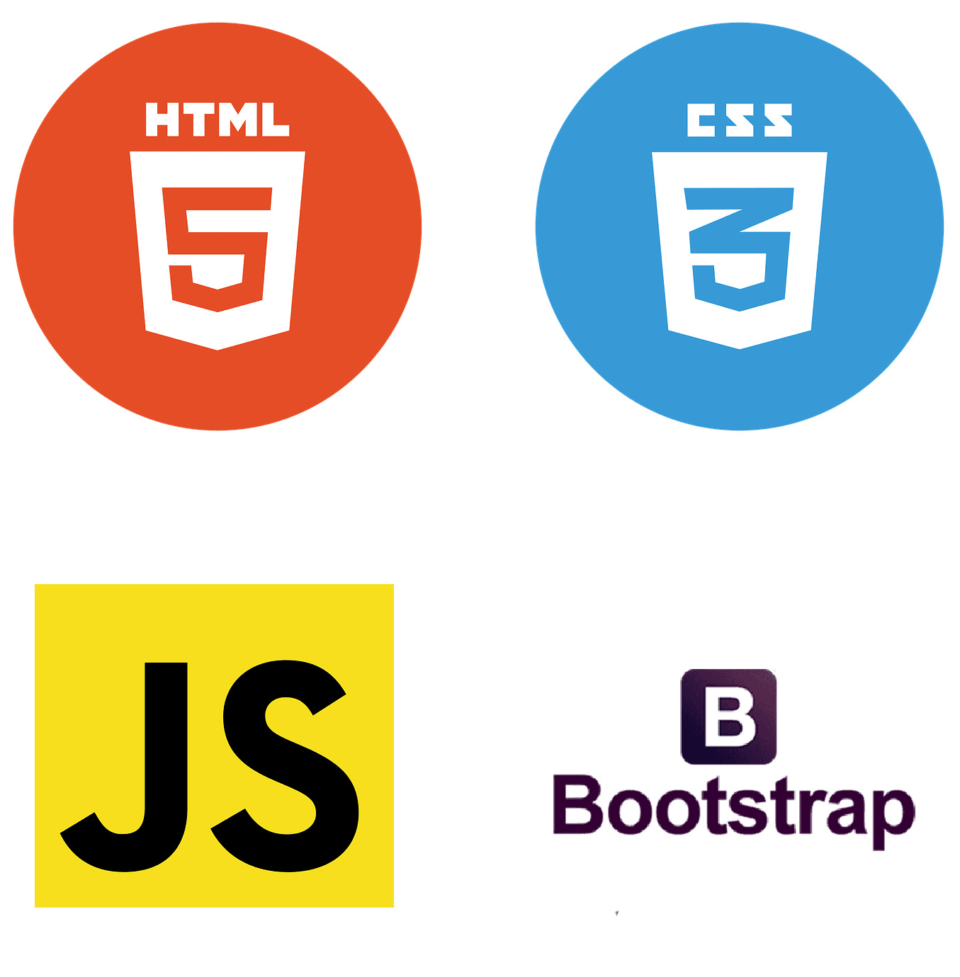
Tools & Languages Used
Backend
PHP for server-side logic.
Database
MySQL for data storage and management.
Frontend

Slide 6
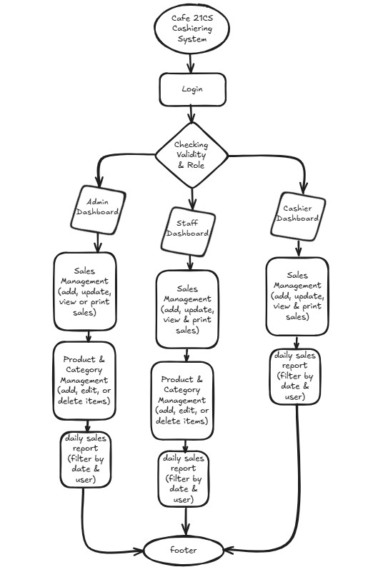

Flowchart

Slide 7
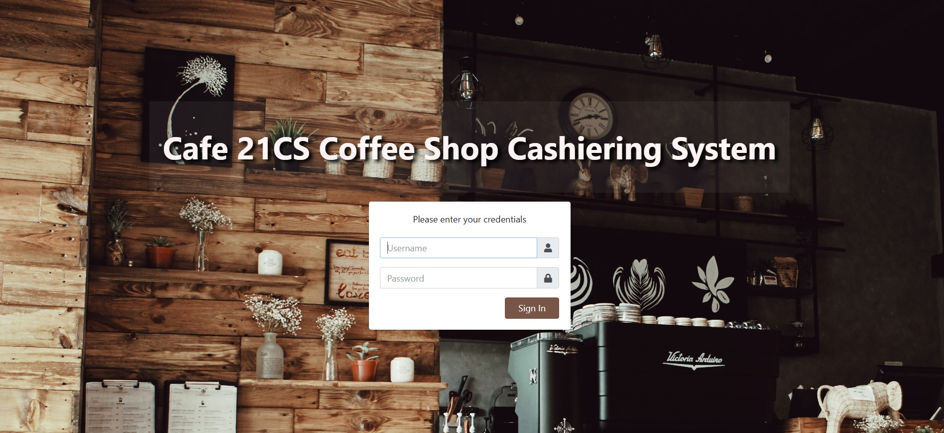
System Working
Authentication with role based access

Slide 8
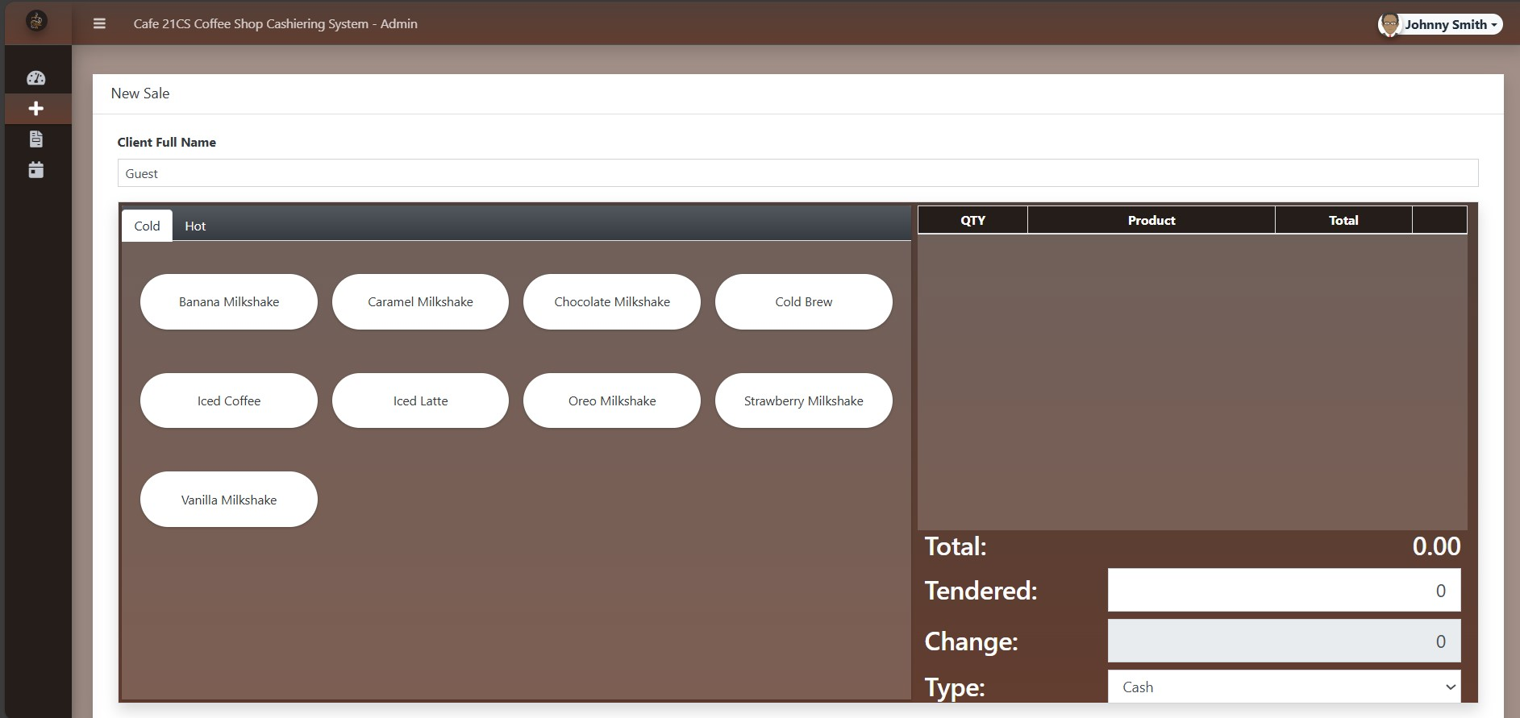
System Working
Sales Transactions: Quick entry and receipt printing.

Slide 9
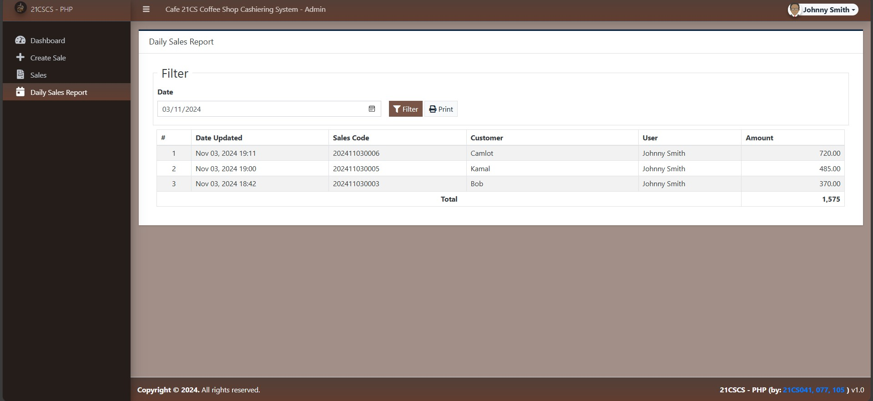
System Working
Reporting: Daily sales insights

Slide 10
Conclusion
The Cafe 21CS Cashiering System is a practical solution designed to help coffee shops manage their daily sales efficiently. Using PHP and MySQL, this system simplifies tasks like tracking sales and managing inventory, making it easier for staff to focus on customer service.

Slide 11
Lets Now Run this Website

